Slide 1
CLOUD STORAGE FOR ELECRTRONIC HEALTH RECORDS BASED ON SECRET SHARING WITH VERIFIABLE RECONSTRUCTION OUTSOURCING
Cloud Storage for EHRs based on Secret Sharing With Verifiable Reconstruction Outsourcing
Nishwa Fathima
Class no: 41 S7 BTECH CSE
12 SEPTEMBER,2018

Slide 2
CONTENTS
Cloud Storage for EHRs based on Secret Sharing With Verifiable Reconstruction Outsourcing
EHR
SYSTEM MODEL
DESIGN GOAL
SHAMIRS SECRET SHARING ALGORITHAM
PROPOSED SCHEME
PERFORMANCE ANALYSIS
CONCLUSION

Slide 3
EHR
Cloud Storage for EHRs based on Secret Sharing With Verifiable Reconstruction Outsourcing
Digital version of patient’s paper chart
Access to evidence-based tools
Advantage of EHR
Economy
Accessibility
Efficiency

Slide 4
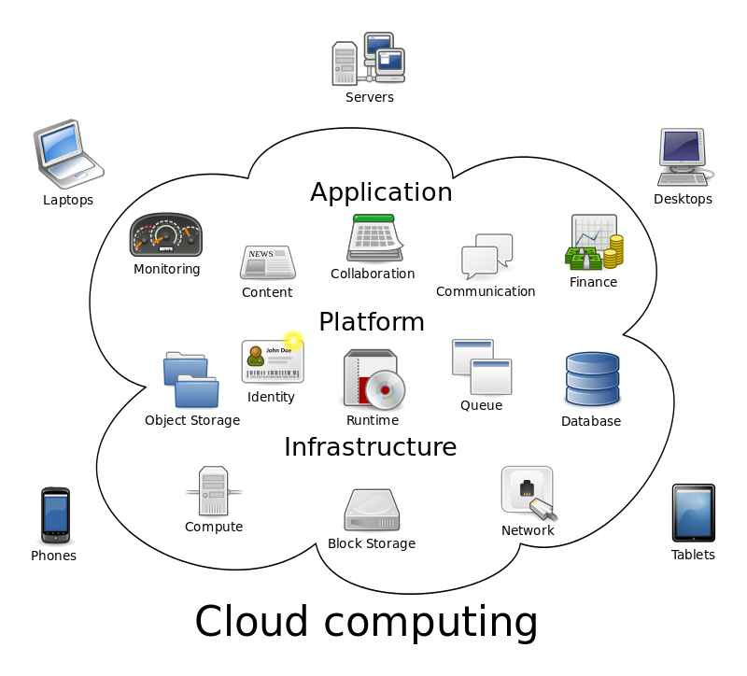
CLOUD COMPUTING
Cloud Storage for EHRs based on Secret Sharing With Verifiable Reconstruction Outsourcing
Shared pools of configurable computer system resources
Adopted in many fields including healthcare
Flexible storing and computing infrastructures
Courtesy : https://en.wikipedia.org/wiki/Cloud_computing

Slide 5
EHR AND CLOUD COMPUTING
Cloud Storage for EHRs based on Secret Sharing With Verifiable Reconstruction Outsourcing
HC’s could avoid the burden of data management
Reduce the cost of storing massive data
Achieve universal data access

Slide 6
SECURITY CHALLENGES
Cloud service providers are not completely trusted
Curious clouds
Maliciously tamper the data
Spy some sensitive information
Security challenges vs appealing for EHR storage

Slide 7
SYSTEM MODEL
Cloud Storage for EHRs based on Secret Sharing With Verifiable Reconstruction Outsourcing
System Architecture
Aiming to limit single point failure problem
Key components
Preprocessing of EHR
Distribution of preprocessed EHR
Reconstruction, outsourcing
Verification and recovery of EHR

Slide 8
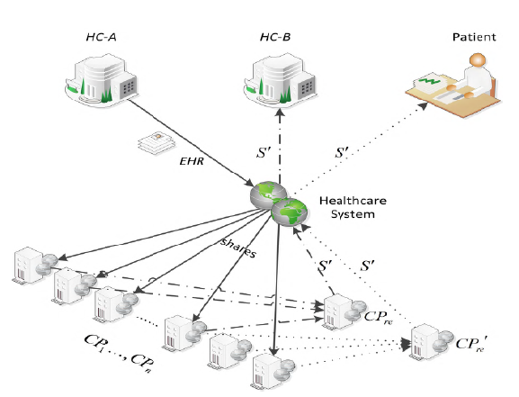
SYSTEM ARCHITECTURE
Cloud Storage for EHRs based on Secret Sharing With Verifiable Reconstruction Outsourcing
Courtesy :https:// ieeexplore.ieee.org/document/8314694

Slide 9
DESIGN GOALS
Cloud Storage for EHRs based on Secret Sharing With Verifiable Reconstruction Outsourcing
Distributed EHR on different CPs
Authorization for acknowledging real content
Reduced computation for client
Reconstruction result are verifiable

Slide 10
SHAMIR SECRET SHARING ALGORITHM
Cloud Storage for EHRs based on Secret Sharing With Verifiable Reconstruction Outsourcing
Algorithm
Secret is divided into parts
Each participant given a unique part.
Reconstruction requires a minimum number of parts
Goal – Divide D into n pieces such that
D computed easily if >k pieces known
D undetermined if <k pieces known

Slide 11
EXAMPLE
Suppose secret is 1234 (S=1234)
Divide the secret into 6 (n=6)
Any subset of 3 parts (k=3) sufficient to reconstruct the secret.
At random we obtain two numbers: 166 and 94.
(a0=1234,a1=199,a2=94)
polynomial to produce secret shares

Slide 12
EXAMPLE(contd..)
6 points D{x-1}=(x,f(x))} from the polynomial:
{ D0=(1,14941);D1=(2,1942);D3=(3,2578);D4(5,4414); D5(6,5614) }
Each participant get a different single point (both x and f(x))

Slide 13

PROPOSED SCHEMA
Cloud Storage for EHRs based on Secret Sharing With Verifiable Reconstruction Outsourcing
Proposed schema consist of 4 phase
Policy is defined by the HC
Storing
Retrieval
EHR divided into m blocks

Slide 14

PREPROCESSING PHASE
Cloud Storage for EHRs based on Secret Sharing With Verifiable Reconstruction Outsourcing
Executed by HCs
HCs generate UID for EHR
Hash value of EHR computed
UID and hash stored in healthcare system
Bitwise XOR done between R and H(R)

Slide 15
DISTRIBUTION PHASE
Cloud Storage for EHRs based on Secret Sharing With Verifiable Reconstruction Outsourcing
Executed by HCs
HCs select m polynomials
HCs computes n shares
Shares and UID distributed to CPs

Slide 16
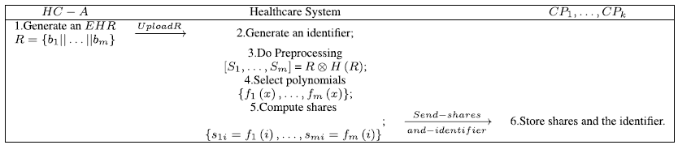
DISTRIBUTION PHASE (contd…)
Cloud Storage for EHRs based on Secret Sharing With Verifiable Reconstruction Outsourcing
Courtesy :https:// ieeexplore.ieee.org/document/8314694

Slide 17
RECONSTRUCTION AND OUTSOURCING PHASE
Cloud Storage for EHRs based on Secret Sharing With Verifiable Reconstruction Outsourcing
Large scale system of linear equations involved
Reconstruction requires massive computations
Client resources are limited
Reconstruction outsourcing scheme to improve efficiency

Slide 18

RECONSTRUCTION AND OUTSOURCING PHASE (contd…)
Cloud Storage for EHRs based on Secret Sharing With Verifiable Reconstruction Outsourcing
Process
Authorization of HCs
HCs outsources reconstruction to a CPRE
CPRE computes S`1,…,S`m using Lagrange interpolation polynomial

Slide 19
RECONSTRUCTION AND OUTSOURCING PHASE (contd…)
Cloud Storage for EHRs based on Secret Sharing With Verifiable Reconstruction Outsourcing
R is blinded by the use of XOR
CPn cannot reveal the original EHR
Reconstruction outsourcing process
Secure against curious cloud server

Slide 20

RECOVERY AND VERIFICATION
Cloud Storage for EHRs based on Secret Sharing With Verifiable Reconstruction Outsourcing
HC receive
S`1,…,S`m from CPRE
H(R) from Healthcare system
HC can recover the result
Calculating each block of R` connecting series
Each block of R`
EHR recovered as

Slide 21

RECOVERY AND VERIFICATION (contd…)
Cloud Storage for EHRs based on Secret Sharing With Verifiable Reconstruction Outsourcing
HC check the equation
Real original EHR only if it holds
Ensures that CPs storing EHR and CPs executing reconstruction are honest

Slide 22
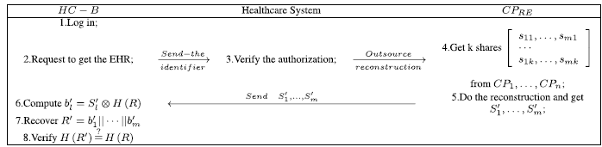
RECOVERY AND VERIFICATION (contd…)
Courtesy :https:// ieeexplore.ieee.org/document/8314694

Slide 23
SECURITY ANALYSIS
Cloud Storage for EHRs based on Secret Sharing With Verifiable Reconstruction Outsourcing
The probability of leaking the EHRs to CPs or CPRE is negligible
The result of reconstruction outsourcing
verified by the health center or patients

Slide 24
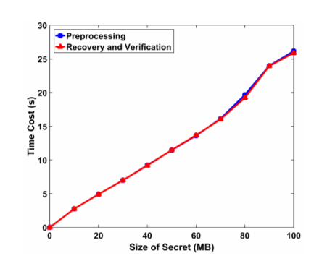
PERFORMANCE EVALUATION
Cloud Storage for EHRs based on Secret Sharing With Verifiable Reconstruction Outsourcing
The time cost comparison among preprocessing, recovery and verification phases
Courtesy :https:// ieeexplore.ieee.org/document/8314694

Slide 25
CONCLUSION
Cloud Storage for EHRs based on Secret Sharing With Verifiable Reconstruction Outsourcing
Privacy-preserving cloud storage scheme for EHR
Based on Shamir’s Secret Sharing
Secure outsourcing approach for the secret reconstruction
The operation cost for healthcare centers and patients can be reduced significantly

Slide 26
REFERENCES
F. Alsolami and T. E. Boult, ``CloudStash: Using secret-sharing scheme tosecure data, not keys, in multi-clouds,'' in Proc. Int. Conf. Inf. Technol.,New Gener., 2014, pp. 315320.
M. J. Atallah, K. N. Pantazopoulos, J. R. Rice, and E. E. Spafford,``Secure outsourcing of scientic computations,'' Adv. Comput., vol. 54,pp. 215272, 2002.
D. Chaum and T. P. Pedersen, ``Wallet databases with observers,'' in Proc.Annu. Int. Cryptol. Conf., 1992, pp. 89105.
X. Chen, J. Li, J. Ma, Q. Tang, and W. Lou, ``New algorithms for secureoutsourcing of modular exponentiations,'' IEEE Trans. Parallel Distrib.Syst., vol. 25, no. 9, pp. 23862396, Sep. 2014.
5. T. Ermakova and B. Fabian, ``Secret sharing for health data in multiproviderclouds,'' in Proc. Bus. Inform., 2013, pp. 93100.

Slide 27
REFERENCES
6. S. Takahashi and K. Iwamura, ``Secret sharing scheme suitable for cloud computing,'' in Proc. IEEE Int. Conf. Adv. Inf. Netw. Appl., Mar. 2013, pp. 530537..
7. J. Lin, W. Yu, N. Zhang, X. Yang, H. Zhang, and W. Zhao, ``A survey on Internet of things: Architecture, enabling technologies, security and privacy, and applications,'' IEEE Internet Things J., vol. 4, no. 5, pp. 11251142, Oct. 2017.
8. L. Rostad and O. Edsberg, ``A study of access control requirements for healthcare systems based on audit trails from access logs,'' in Proc.Comput. Secur. Appl. Conf., 2006, pp. 175186.
9. H. Löhr, A. R. Sadeghi, and M. Winandy, ``Securing the e-health cloud,''in Proc. ACM Int. Health Inform. Symp., 2010, pp. 220229.
10. A. Shamir, ``How to share a secret,'' Commun. ACM, vol. 22, no. 11,pp. 612613, Nov. 1979.

Slide 28
THANK YOU
Cloud Storage for EHRs based on Secret Sharing With Verifiable Reconstruction Outsourcing

